Slide 1
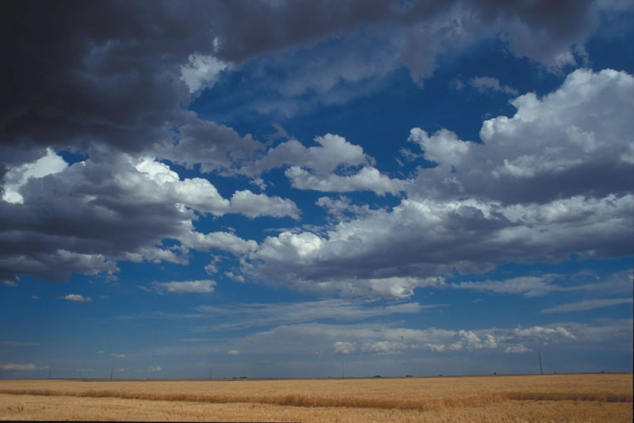
Cross-Country for Beginners
Part 2: Thermals and Triggers
Bill Elliott and Rand Baldwin

Slide 2


My two favorite books

Slide 3


Two new books that are good

Slide 4

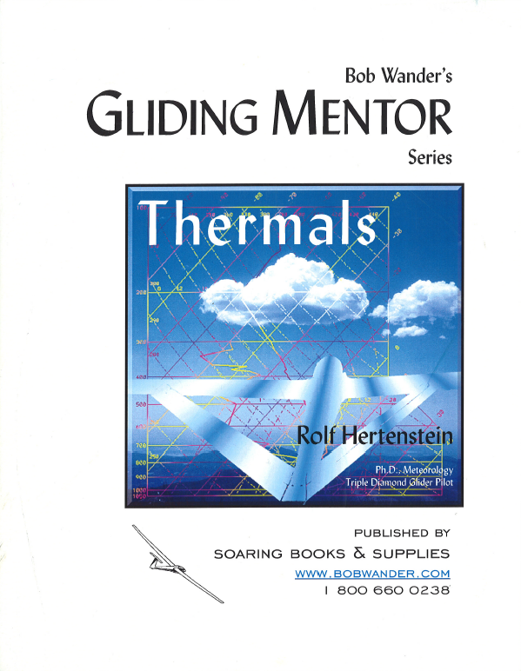
And, two more books

Slide 5
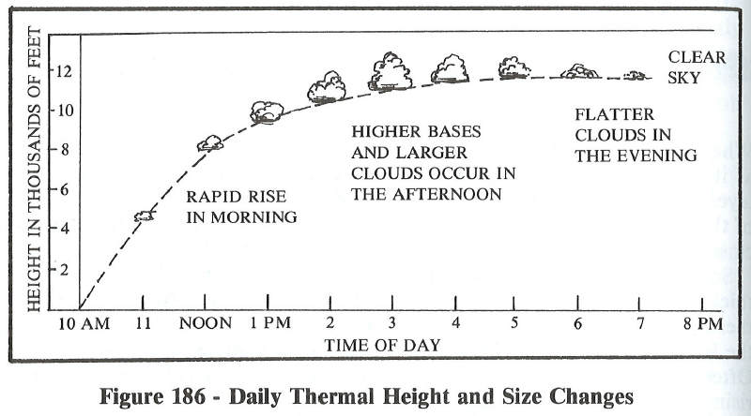
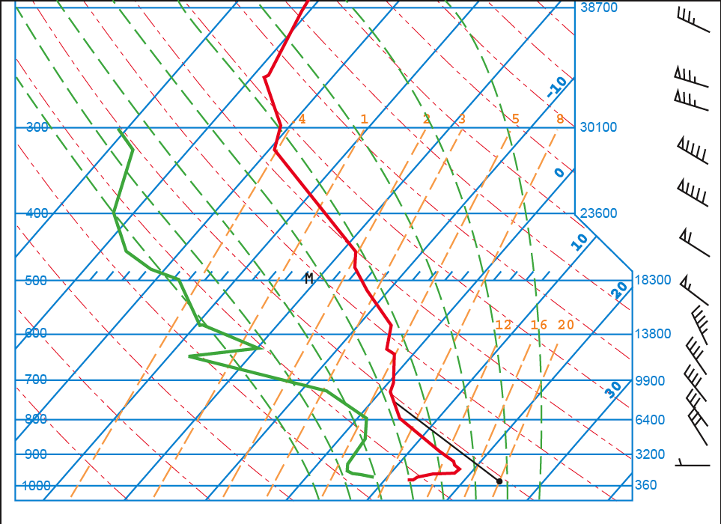
Review: The Skew-T Plot
As temp rises, so does cloudbase
Height of
Convection
Surface Temperature

Slide 6
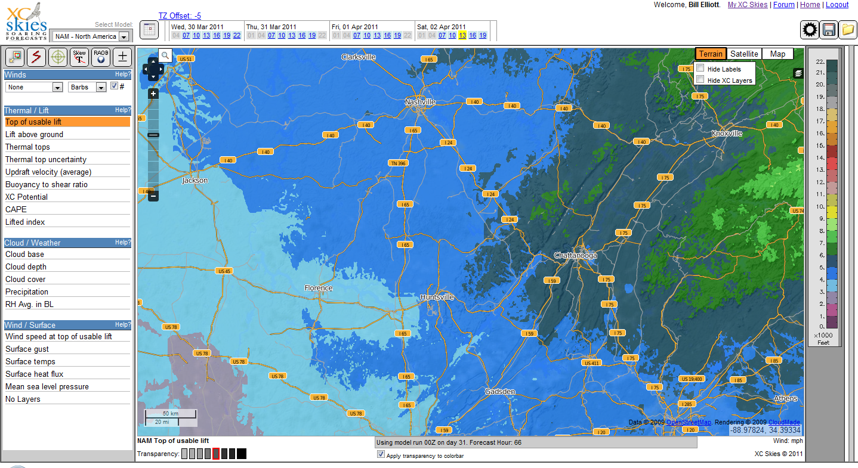

Slide 7
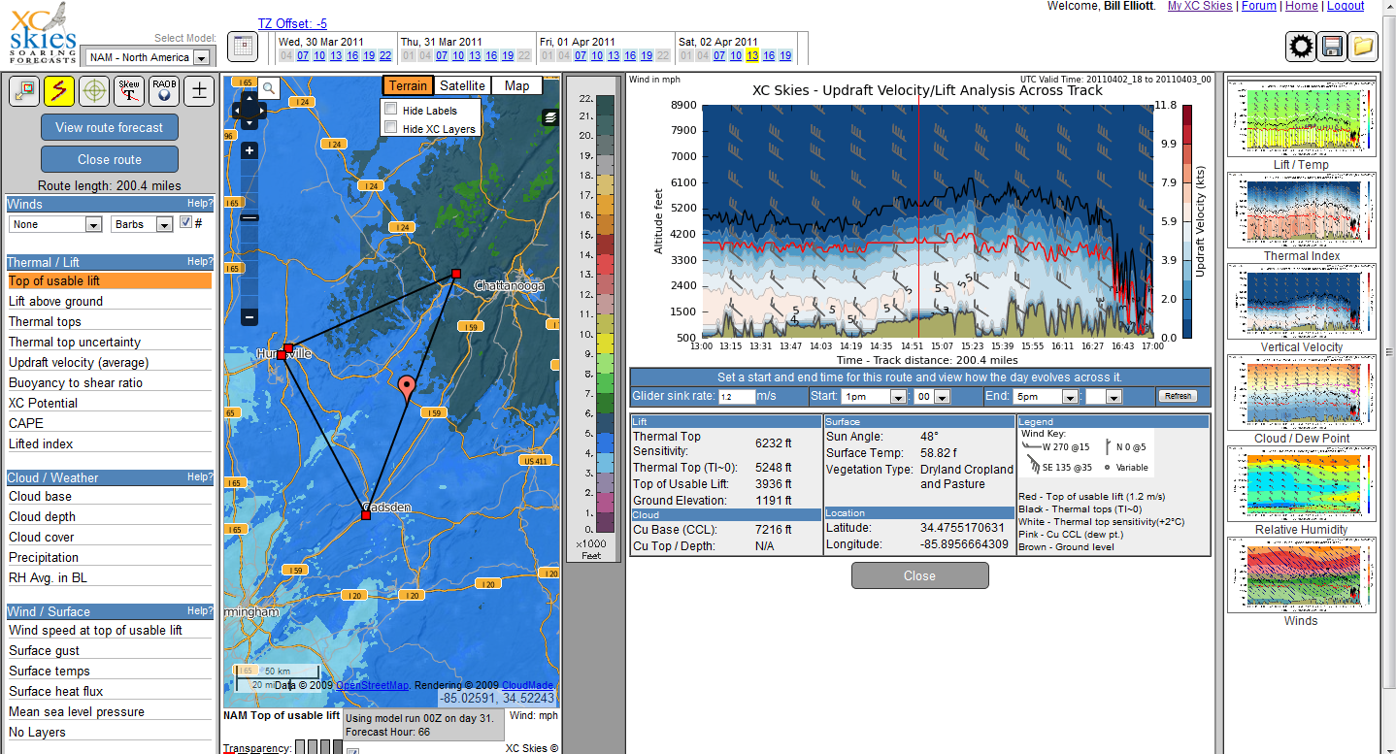

Slide 8
Desired Outcome for Lesson 2
Gain a better understanding of a thermal’s nature
  As a function of altitude
  As a function of time of day
  As a function of wind and terrain
  As a function of cloud cover
Implications of the above
for finding thermals
Understand the importance of thermal triggers
This will then be a nice setup for Lesson 3: Climbing

Slide 9
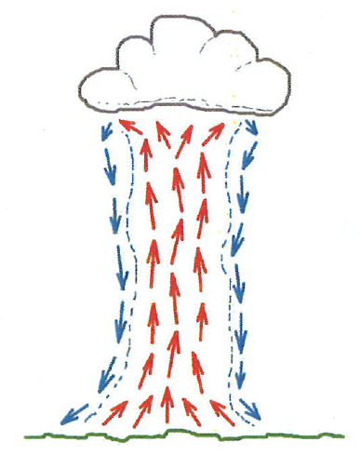
The Idealized Thermal
We tend to picture a thermal as a column of air
Rising Air in the middle
Sinking air at the edges
This works for discussions; but, few thermals look much like this!
BGD, p. 54

Slide 10
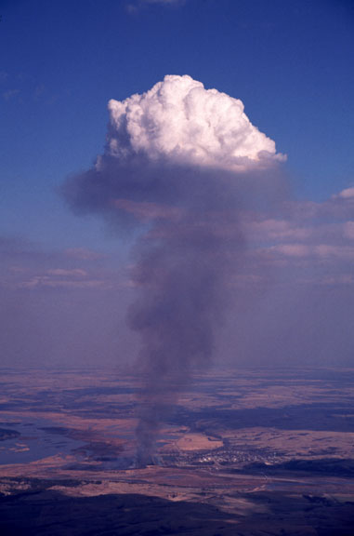
So that’s what one looks like!
Conical in shape
Note the regions of reverse flow at various points on the cone surface
Depending on the height at which you encounter this thermal there will indeed be a significant downdraft on entry, but not at all heights or from all directions.
The thermal does indeed get bigger as it rises, and
Its quite clearly not homogeneous.

Slide 11
A Better Representation
Narrow at the base
Broader at altitude
Churning internally
Constant Flow
Discrete Bubbles
Strength Varies
Strong in middle
Weaker at edges
Sink surrounding
Notes:
Teaching Point
Various thermal models are similar
Small lower, bigger higher
Stronger middle, weaker or sink outside
Churning
Not the same strength at all altitudes
Weak/narrow lower
Strongest in middle
Can fizzle out before cloudbase

Slide 12
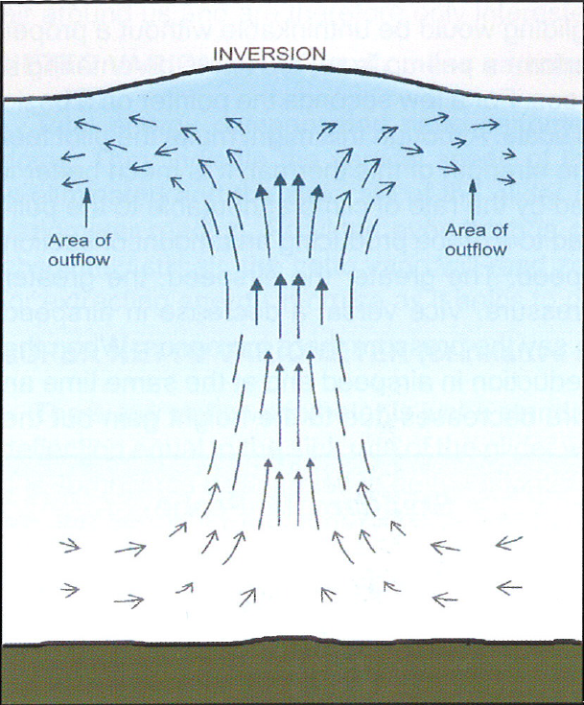
Sink or Outflow at the Top?
ASME, p. 226

Slide 13
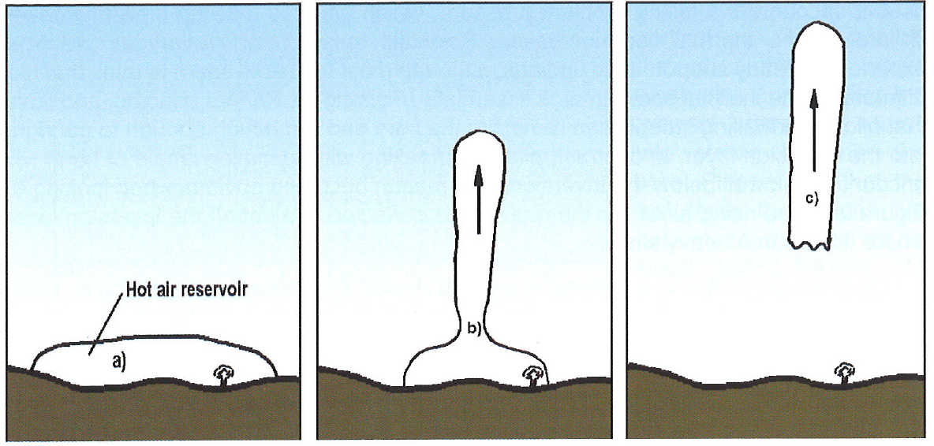
Back to the Idealized Thermal
The sun heats the ground which, in turn heats the air above it.
Something triggers the hot air reservoir and causes it to release.
It ascends as a column or bubble and can last 20-30 minutes or longer.
ASME, p. 36

Slide 14
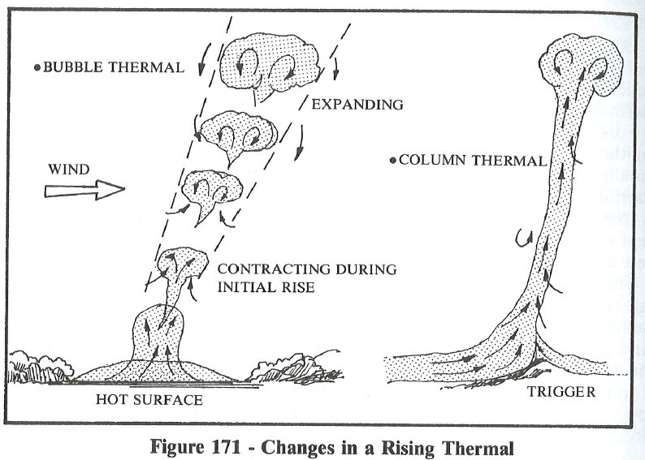
Bubbles vs Columns

Slide 15
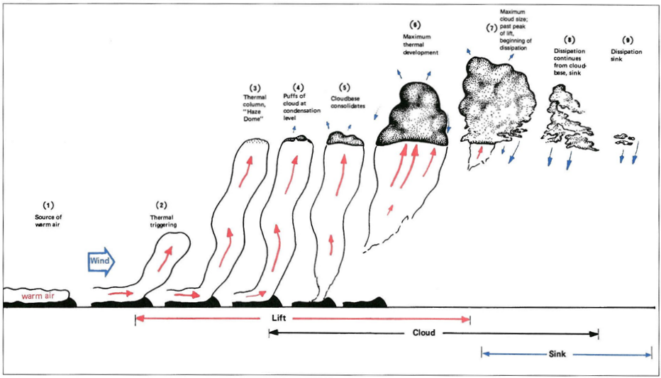
Life Cycle of a Thermal
The air “turns over” six times in a day.
Note the need for a triggering point – good to know when searching low

Slide 16
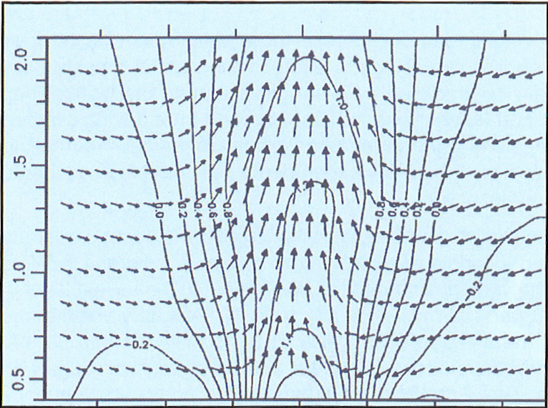
Cross-Section of a Thermal
(not much sink at the edges)
ASME, p. 34

Slide 17
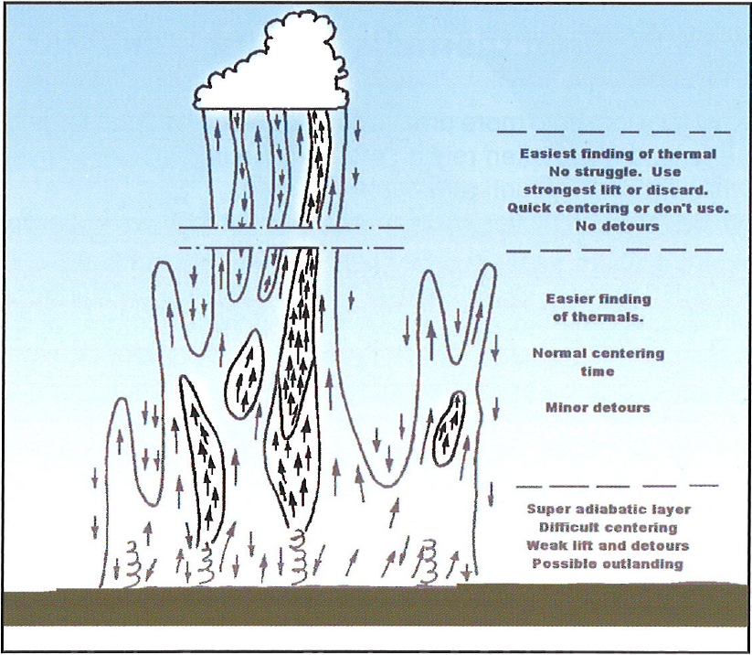
Thermals as f(altitude)
ASME, p. 35

Slide 18
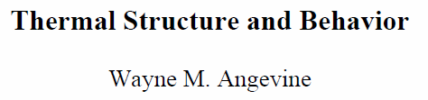
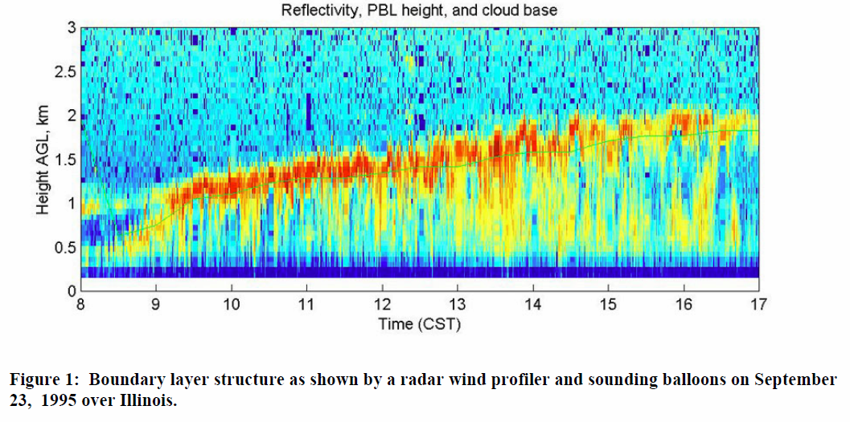
Laser Radars Profiles

Slide 19
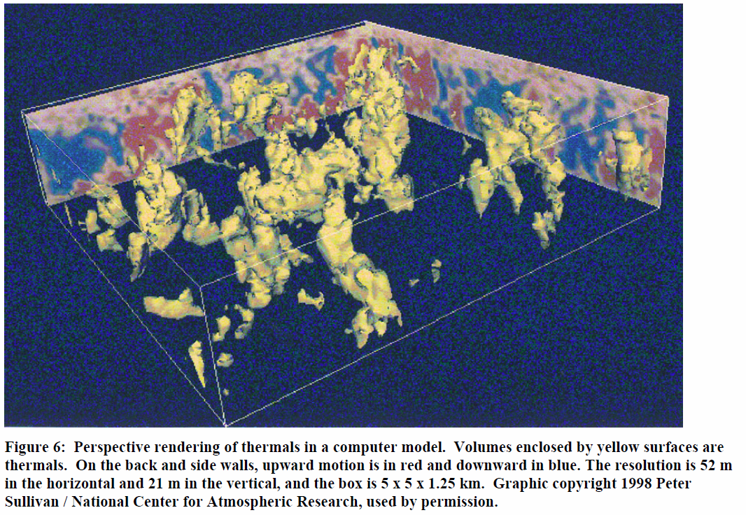
Thermals are not regular columns of rising air.

Slide 20
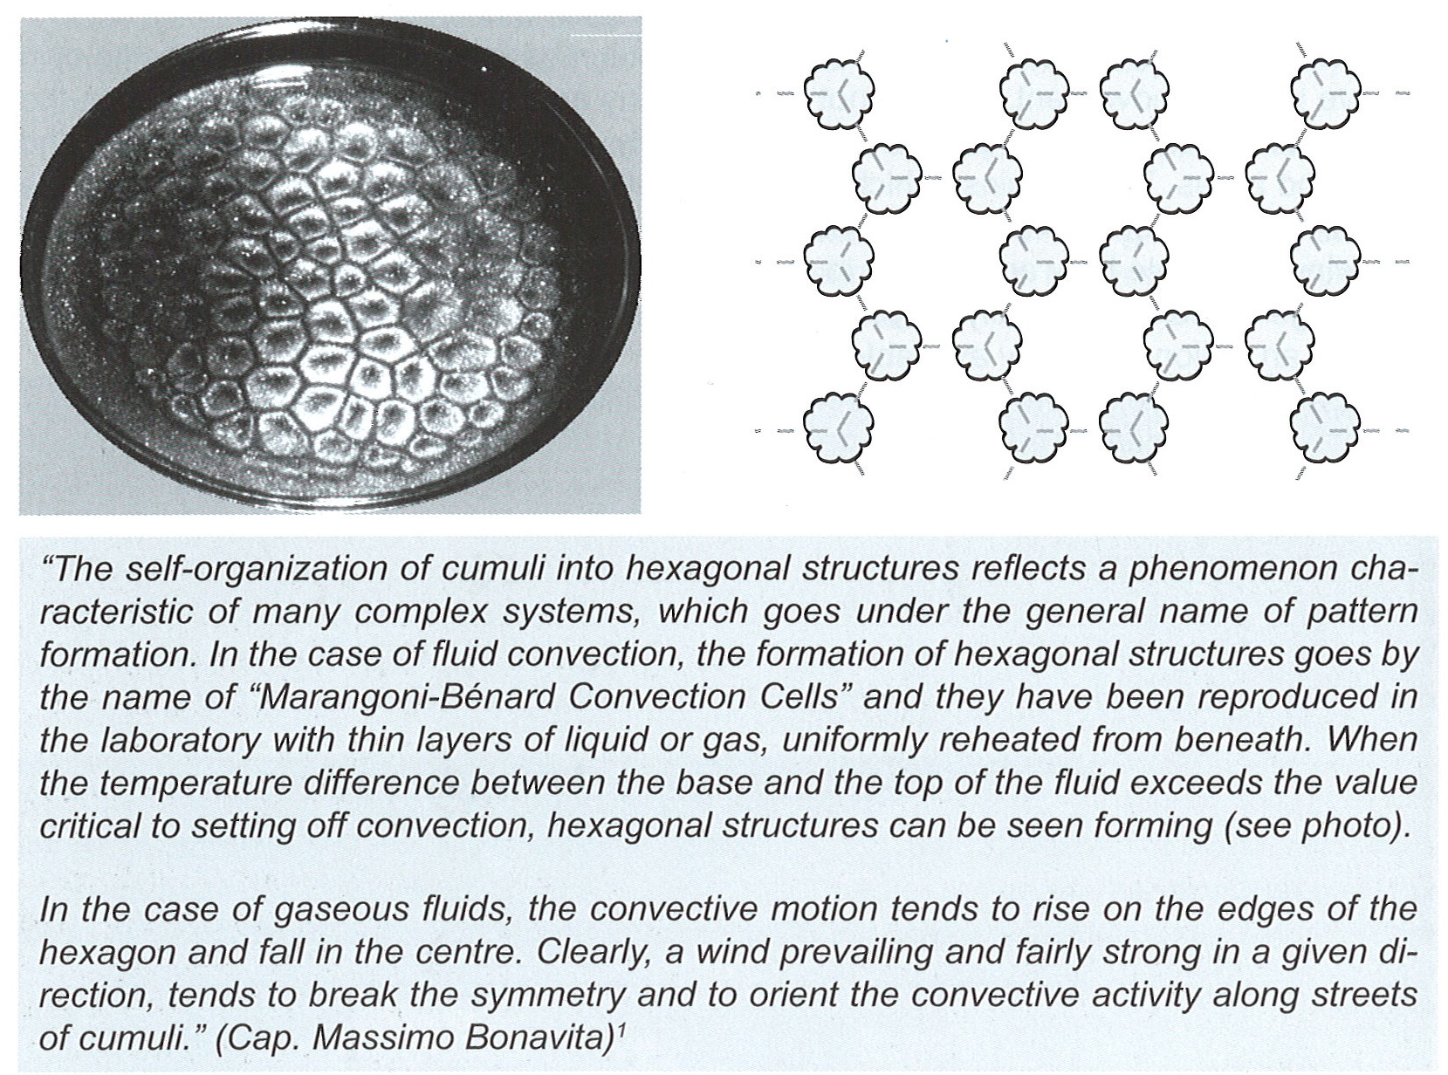
No Wind and Energy Lines Seem Crooked
WWTM, p. 64

Slide 21
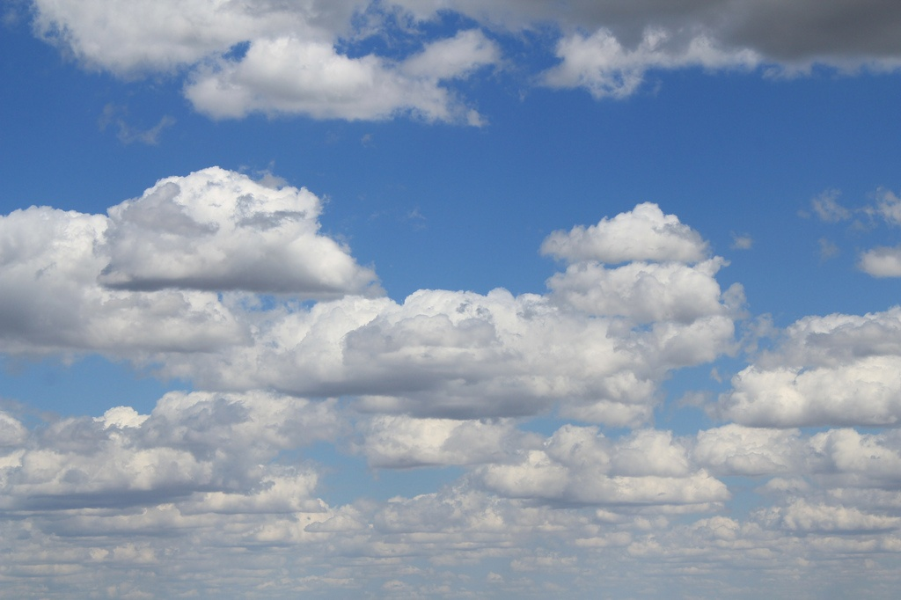
Somewhat random but energy lines are visible

Slide 22
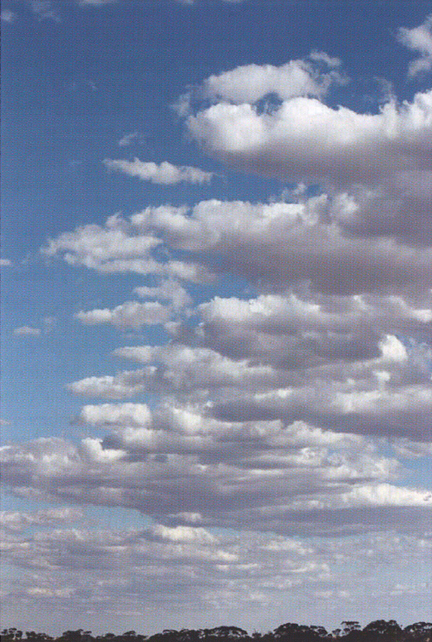
Winds Cause Streeting
A steady flow causes the lift to line up and the Streets to form
Streets are usually 2 ½ times cloudbase height apart with sink in between (see next chart).
Non-parallel winds above the clouds can cause wave and therefore amplifies the sink
Blue days have streets too!
ASME, p. 163

Slide 23
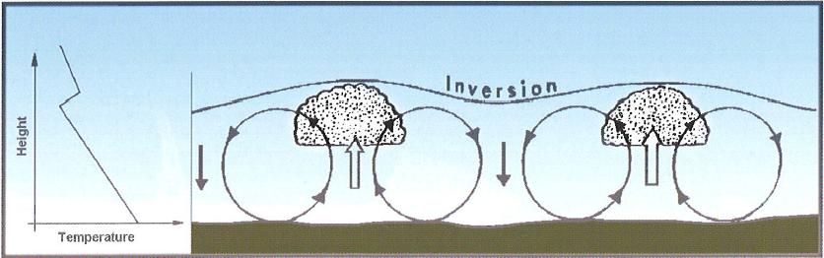
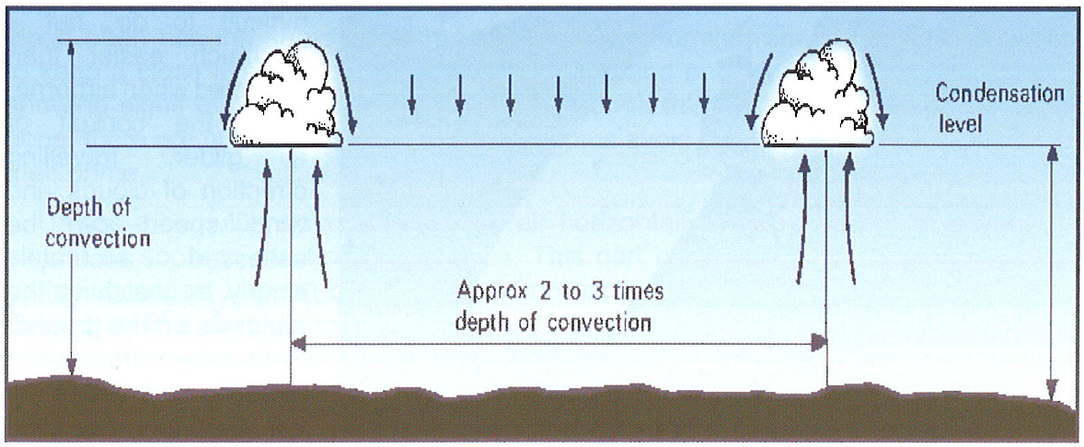
Lift and Sink around Streets
ASME, p. 160
ASME, p. 45

Slide 24
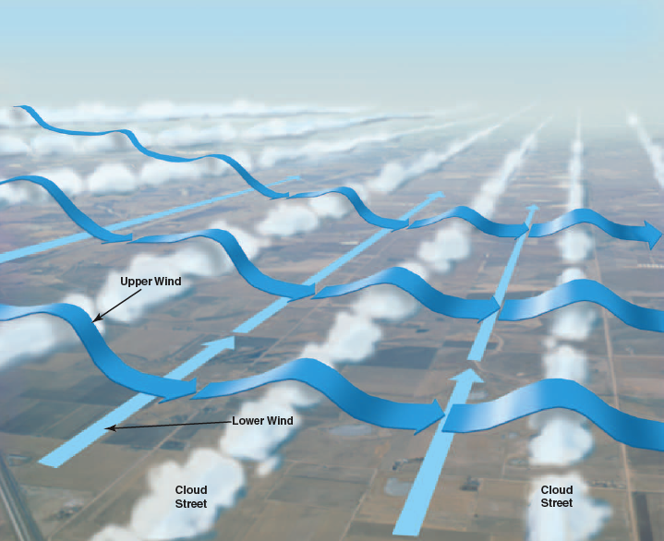
Cloudstreet Waves

Slide 25
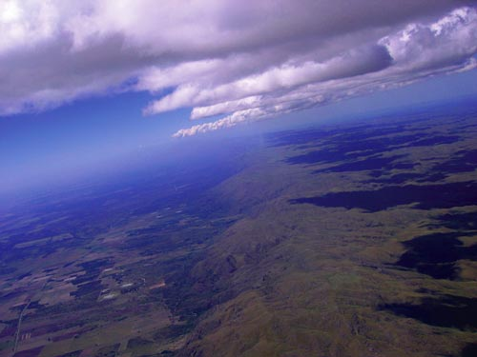
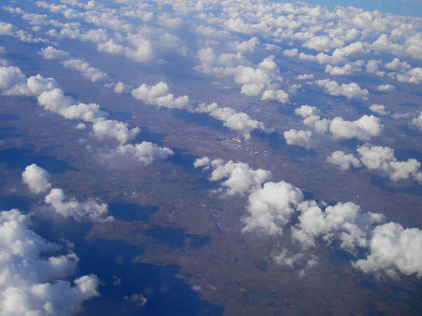
Cloudstreets
Most cloudstreets are due to the wind (see below) and can extend for over 100 miles as in West Texas.
Some streets are formed due to terrain where the sun heats a mountain side and causes the same pattern to form. This can happen in places like the Sequatchie Valley or over the White Mtns in Nevada.

Slide 26
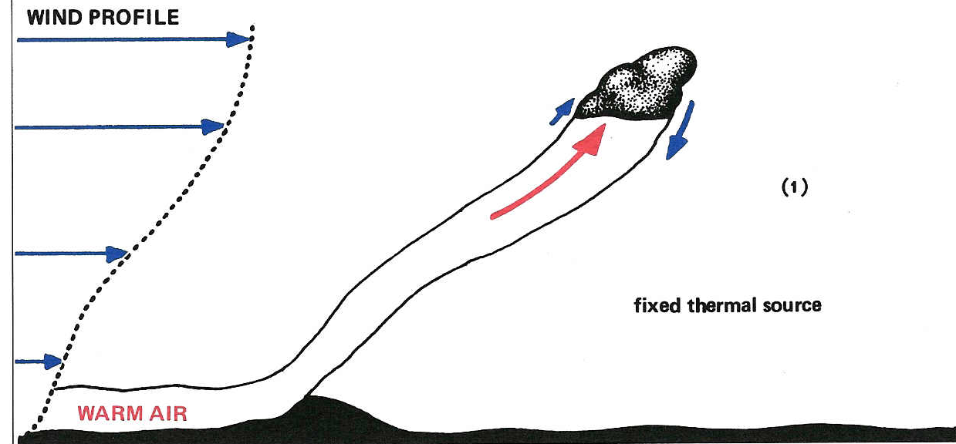
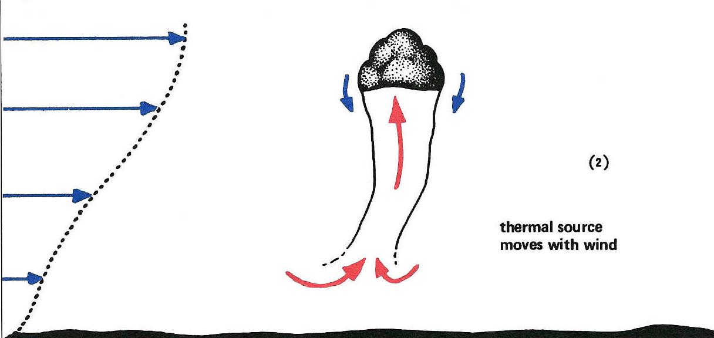
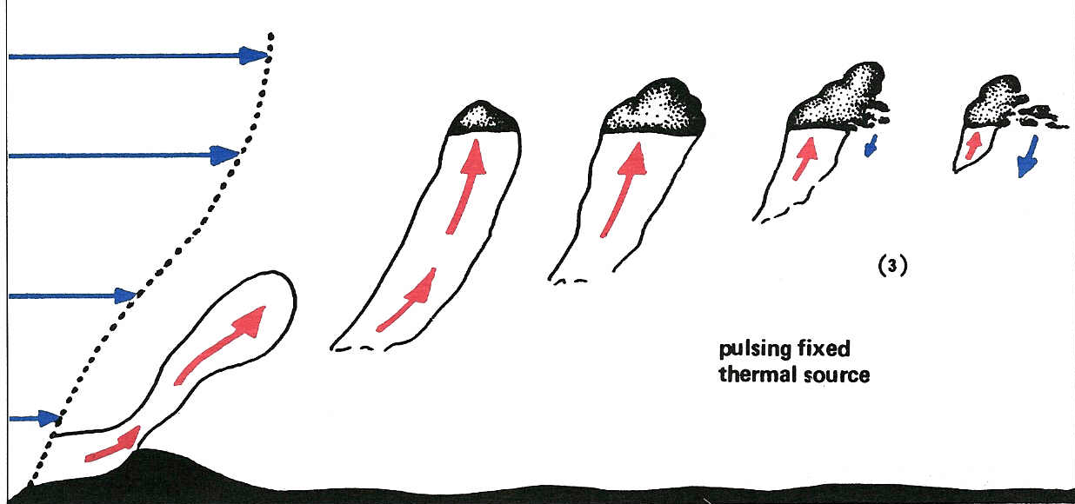
Wind, Bubbles & Pulses

Slide 27
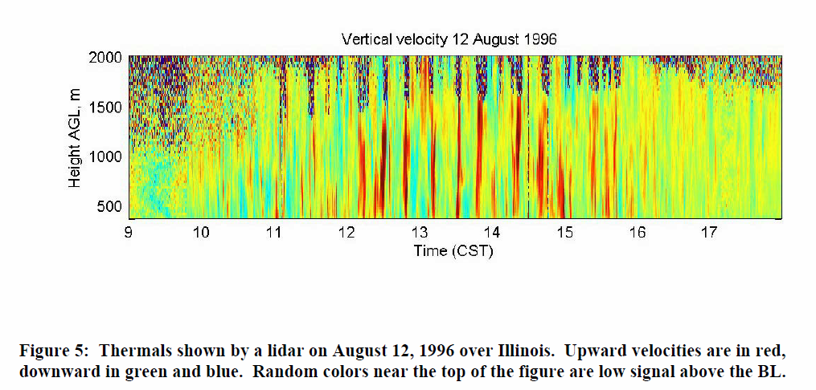
These data indicate that, over time, a source will continue to provide a steady cycle of thermals or bubbles.
This means that you can return to the same source and is why we have “house thermals”.

Slide 28
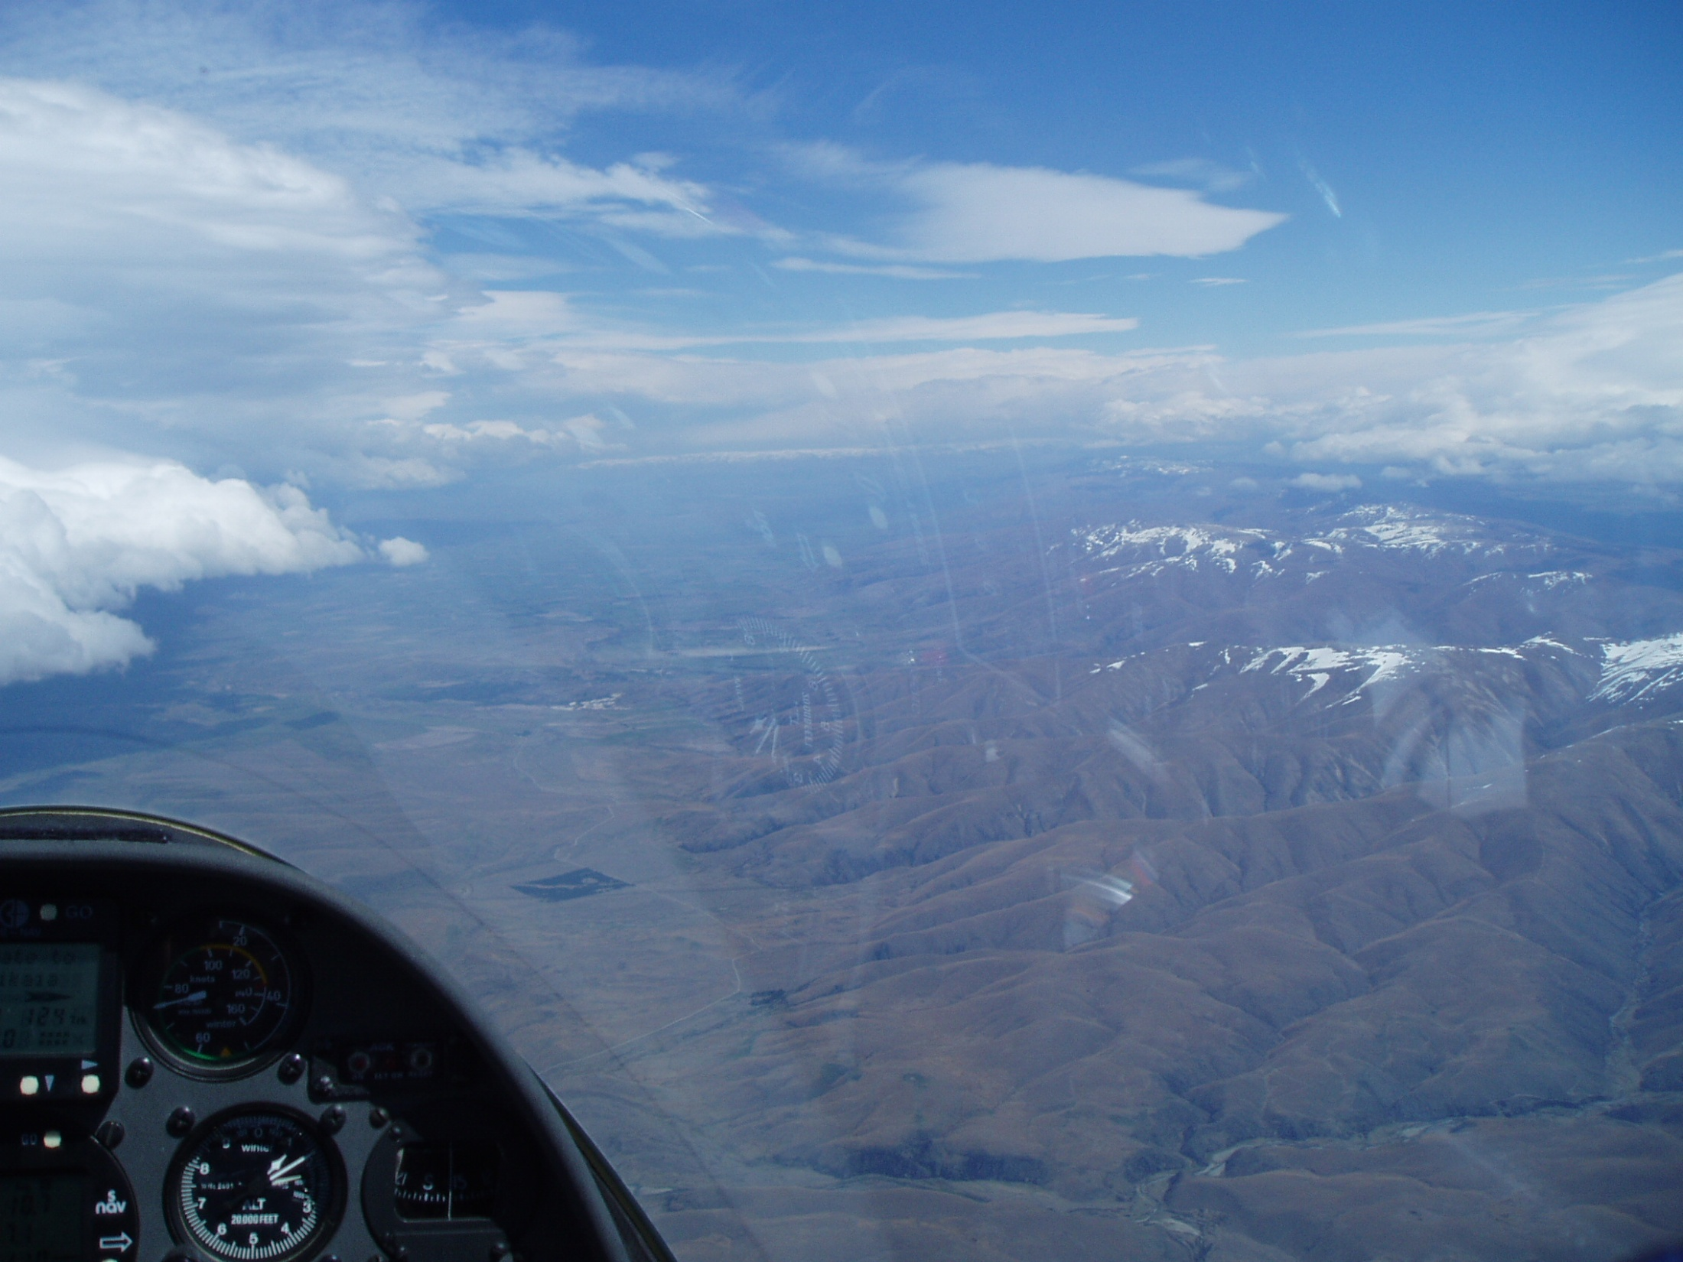
“Know Thy Winds!”
-- a quote from Gavin Wills --
What is the wind at altitude?
How do you know?
  Flight computer
  Drift of glider while thermaling
  Movement of cloud shadows on the ground
What is the wind on the ground?
How do you know?
  Smoke from small fires
  Wind signs on the water (ponds)
  Trash moving in a field
Are the winds the same … probably not.
Thermals will cause a distinct shift in the
wind direction on the ground so pay attention.

Slide 29
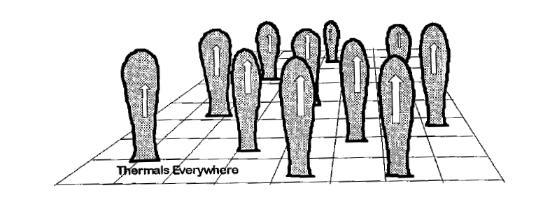
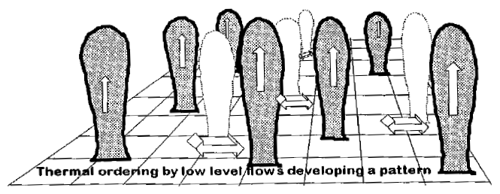
Thermal Spacing vs Time of Day
FF&F1, p. 39

Slide 30
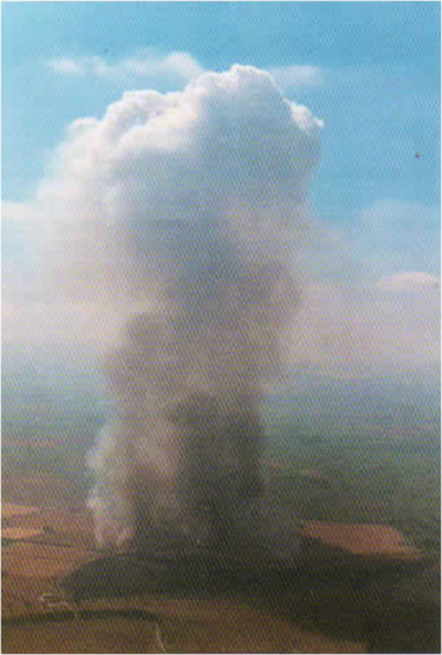
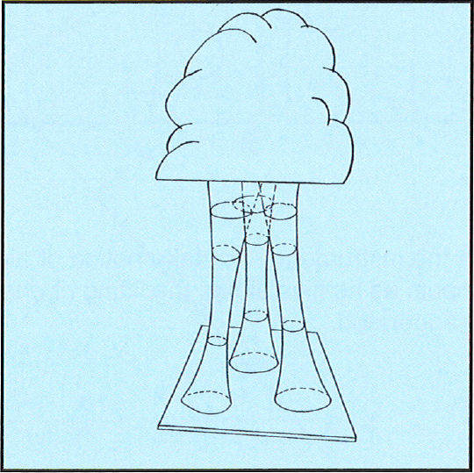
Multiple Sources Often Converge
ASME, p. 32

Slide 31
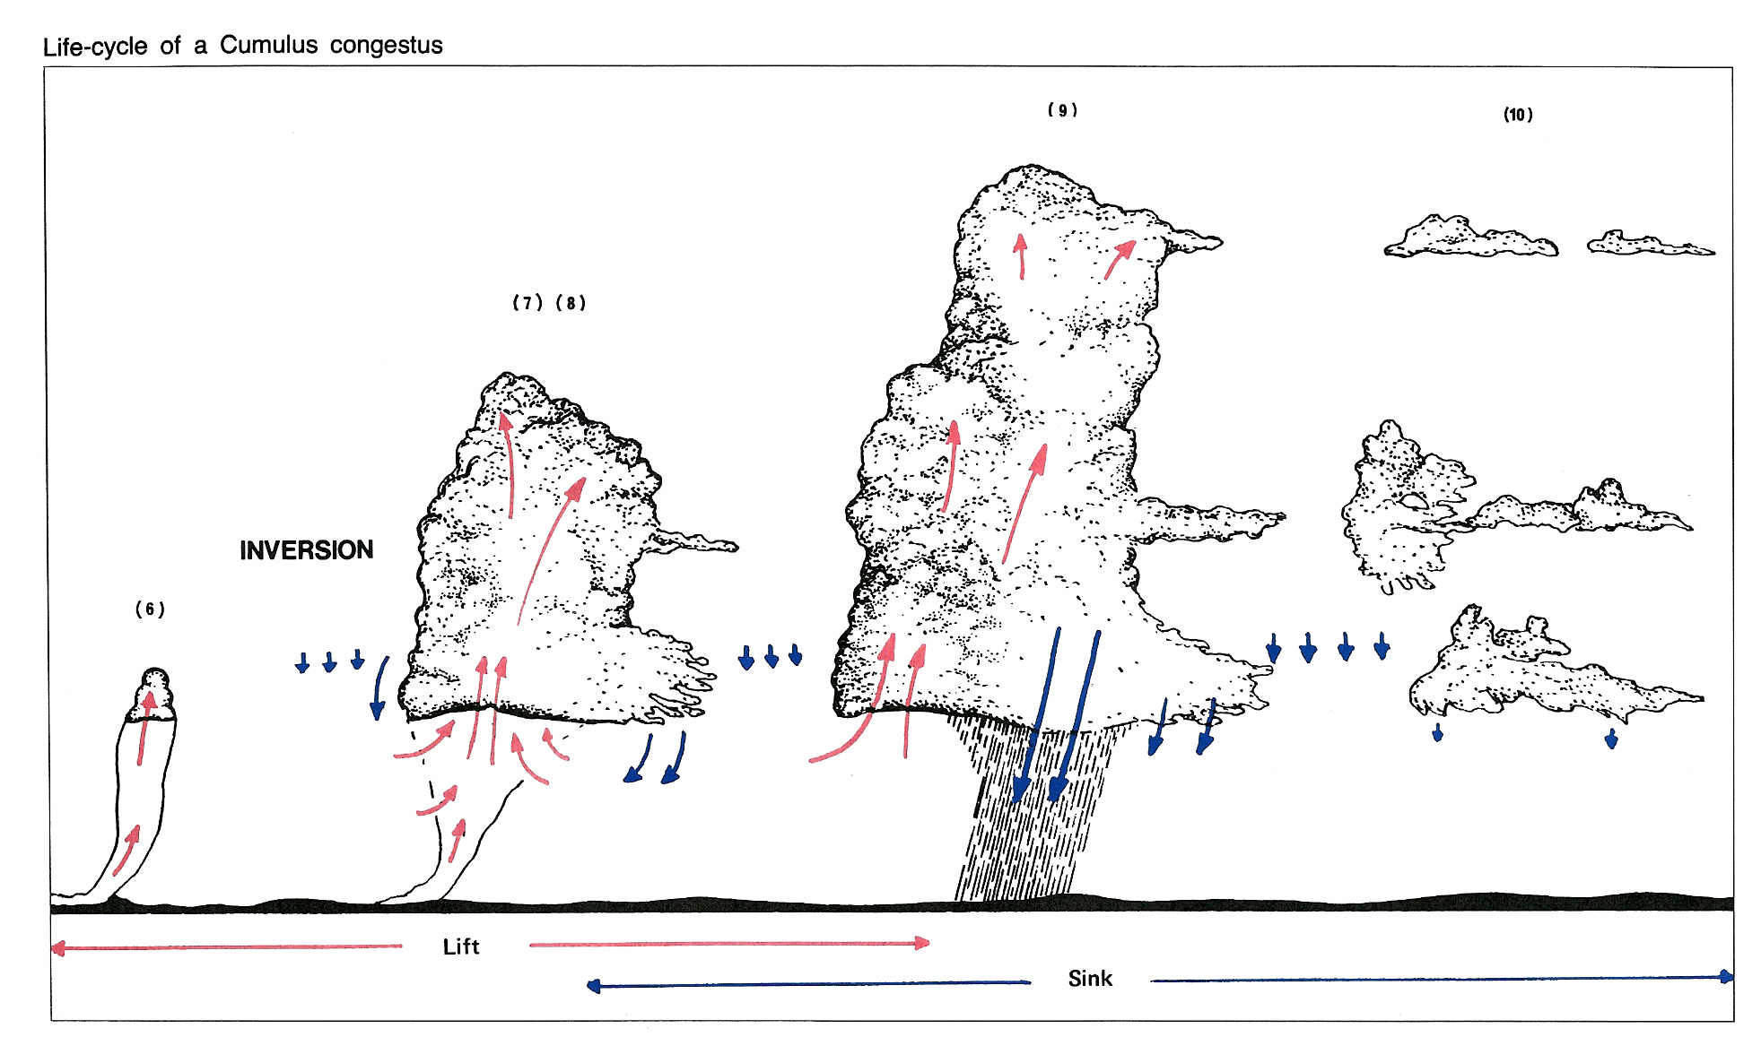
Cumulus Congestus: Plan Ahead

Slide 32
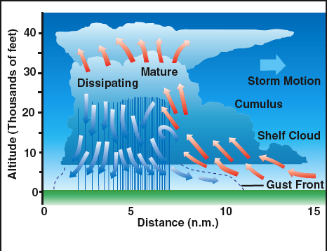
Cb’s have a good side and a bad side!
The path behind usually smooth air.

Slide 33
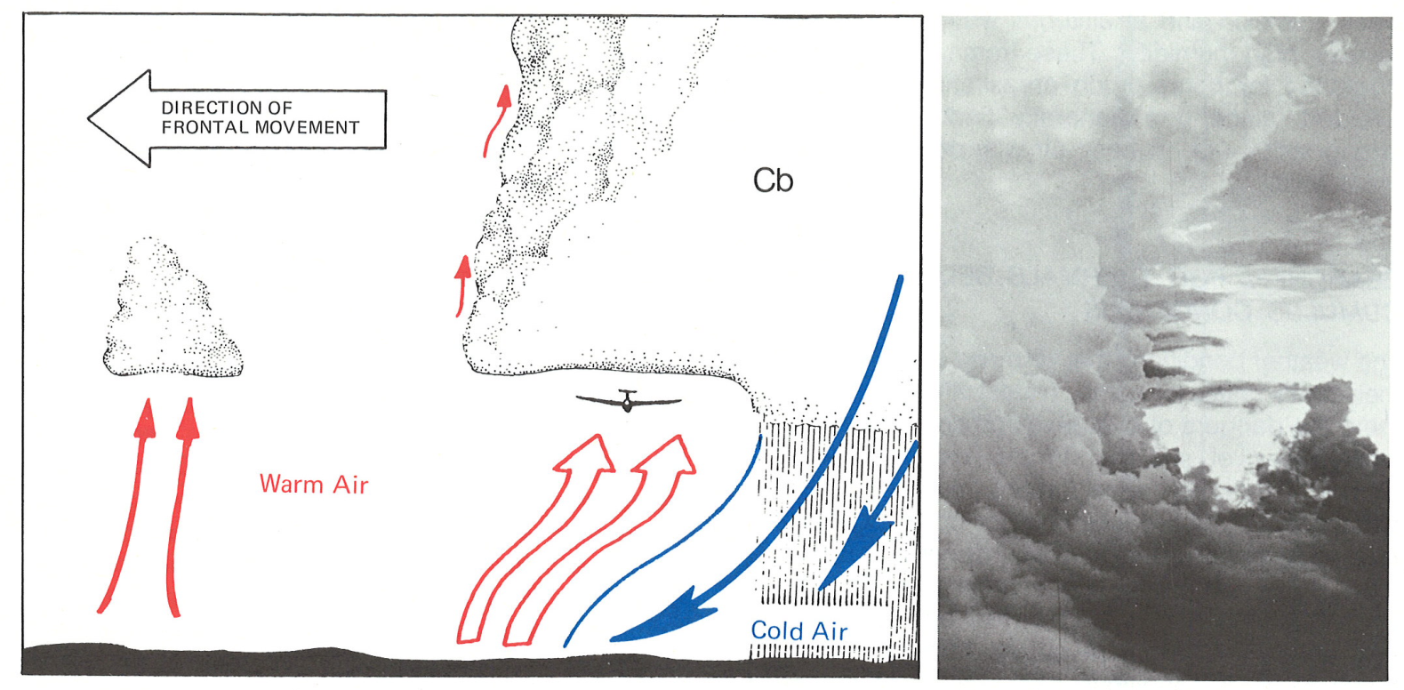
Cumulo-nimbus: Ride the Shelf
Cb’s offer many possibilities. Always be extra careful and watch out for:
1) getting sucked into the cloud, 2) tremendous downdrafts, and 3) lightning
Reichmann, p. 22

Slide 34
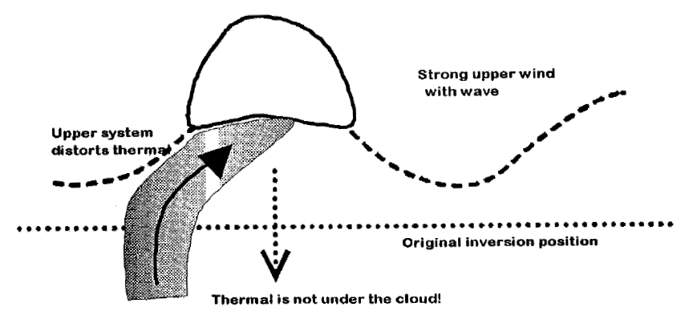
Lift is where you find it
Lift is not always under the cloud. Try to understand the pattern as it will usually be consistent since the thermal location is caused most often my the wind. Once you know the pattern, use it to find the thermal at mid-levels below the cloud.
FF&F1, p. 42

Slide 35
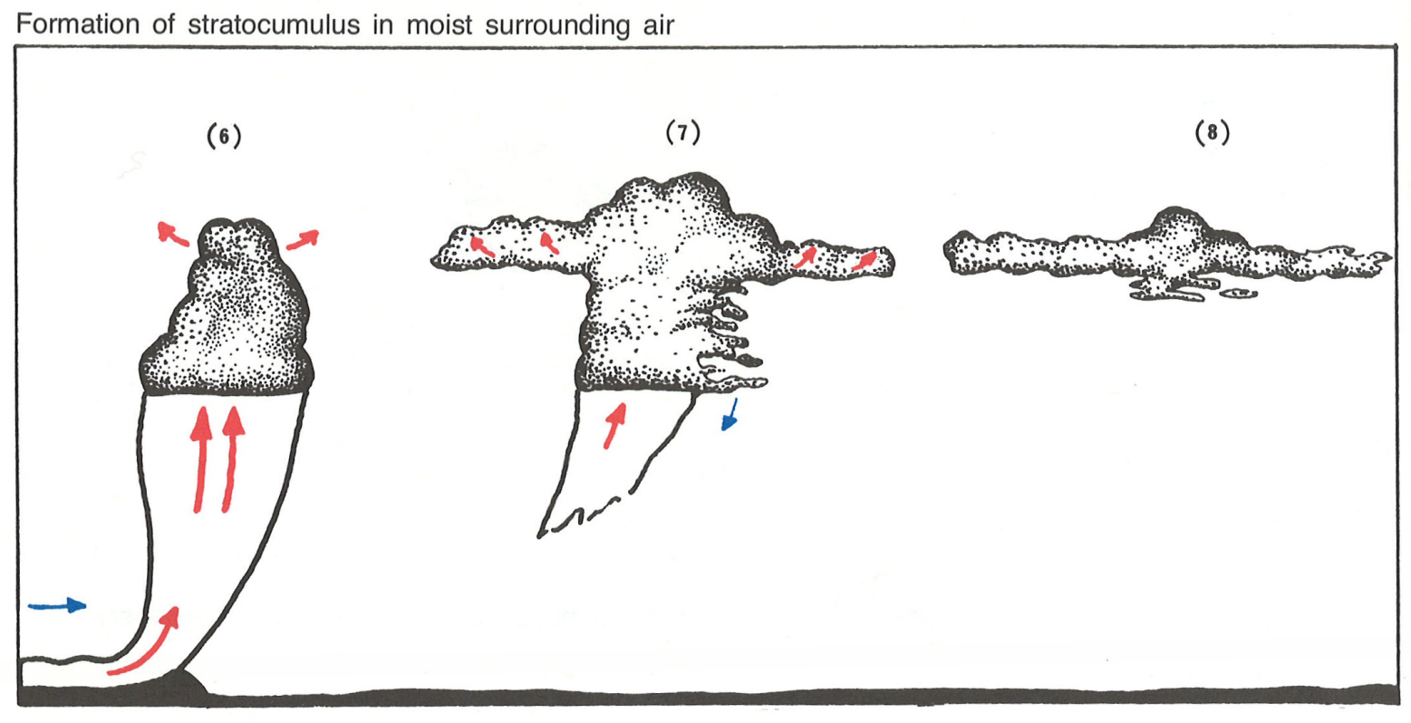
Strato-Cumulus or “Spreadout”
If the dewpoint at cloudbase is very close to the Environmental Lapse Rate at that altitude, then “spreadout” is a possibility. Lift is present, but stay high near cloudbase.
Reichmann, p. 18

Slide 36
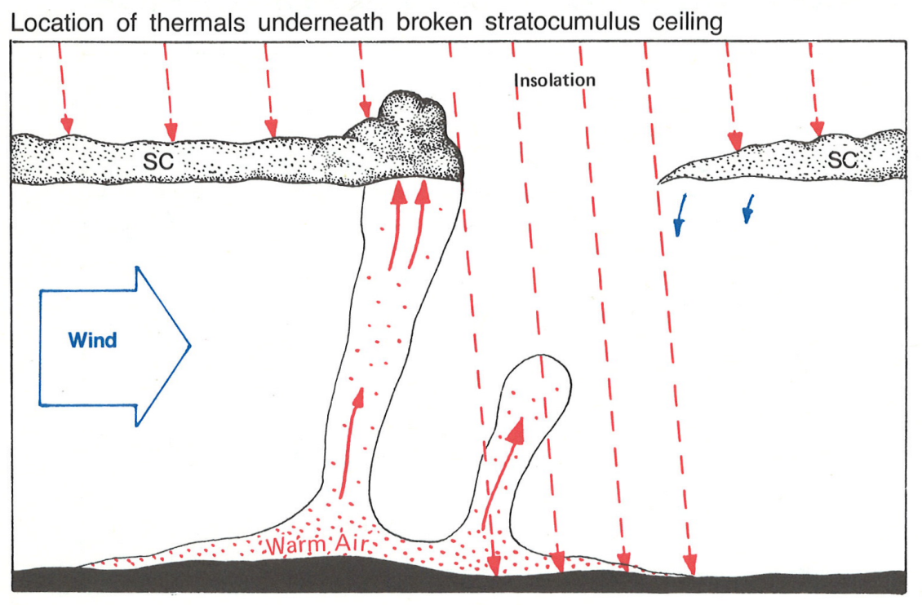
Go to the light!
A shadow, or edge, can trigger thermals.
Reichmann, p. 18

Slide 37
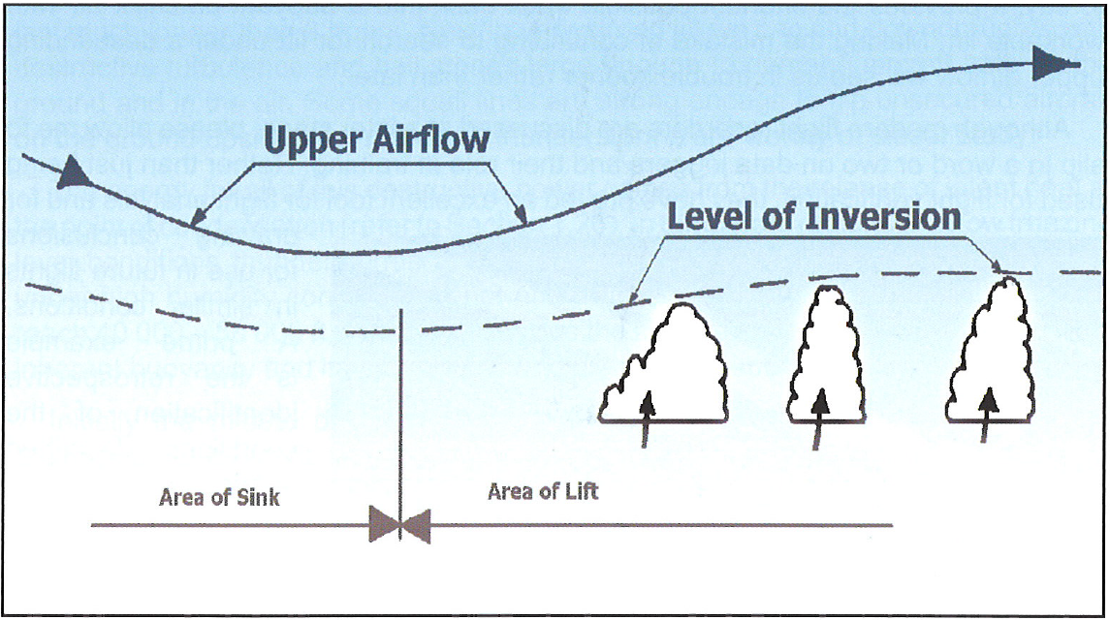
Remember: It’s blue for a reason
Some reasons: The area just cycled, high cirrus, wet ground, recent rain, atmospheric depression (as shown below), sink streets … and other reasons we don’t know!
ASME, p. 131

Slide 38
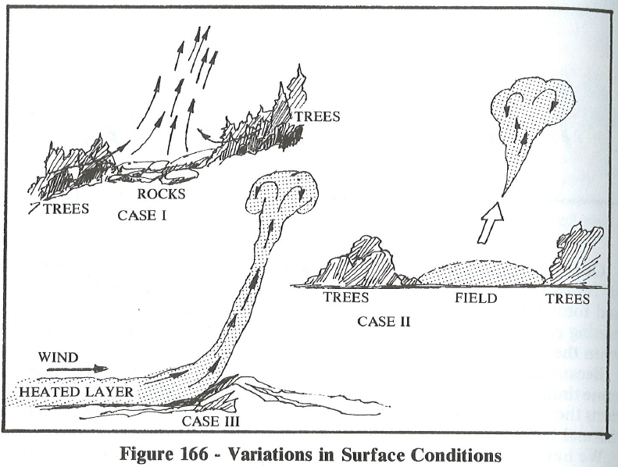
Thermal Triggers

Slide 39
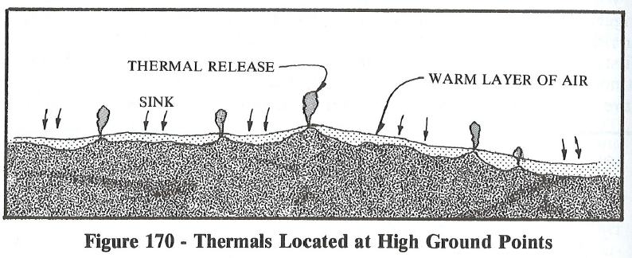
High Ground
High ground can be many things: A mountain, a hill, a house, a rock pile, a clump of trees, a telephone pole … whatever, “high ground” is a relative term.
I’ll say it again, “Always go to the high ground!”

Slide 40
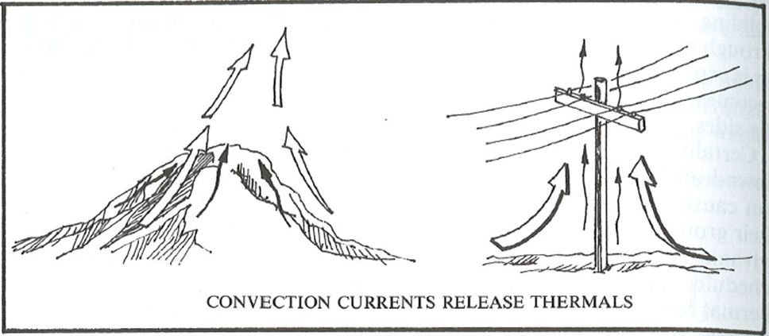
Know Thy Winds!
-- or, know that winds also trigger thermals --
The winds also setup the thermal triggers
  Any obstacle downwind of a field (or large open area)
  The edge of a forest
  A valley will funnel thermals up a slope
Places protected from wind can be a thermal source
  Fields surrounded by trees
  Areas on the lee side of a hill; especially if winds are light
  Rock quarries

Slide 41
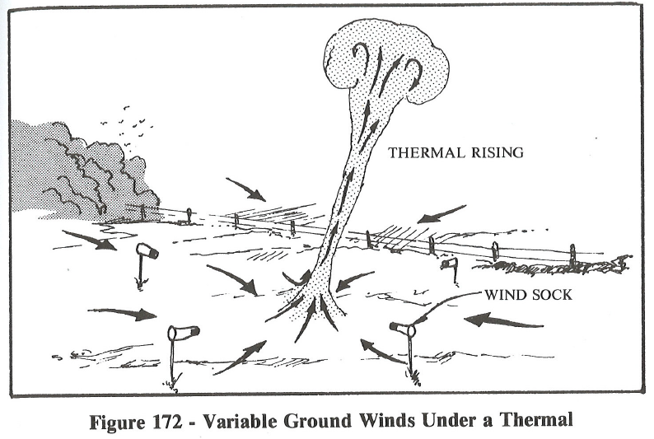
Thermals cause local winds …
… which point to the thermal

Slide 42
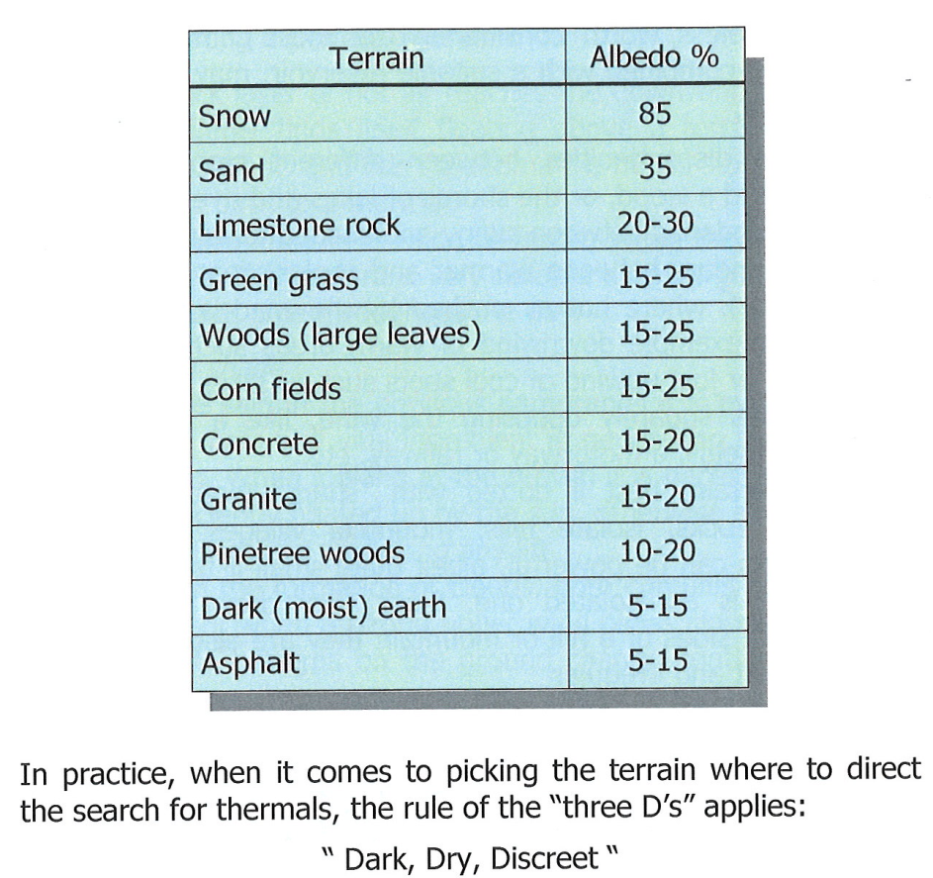
Thermal Sources: Dark, Dry Discreet
BGD, p. 95

Slide 43
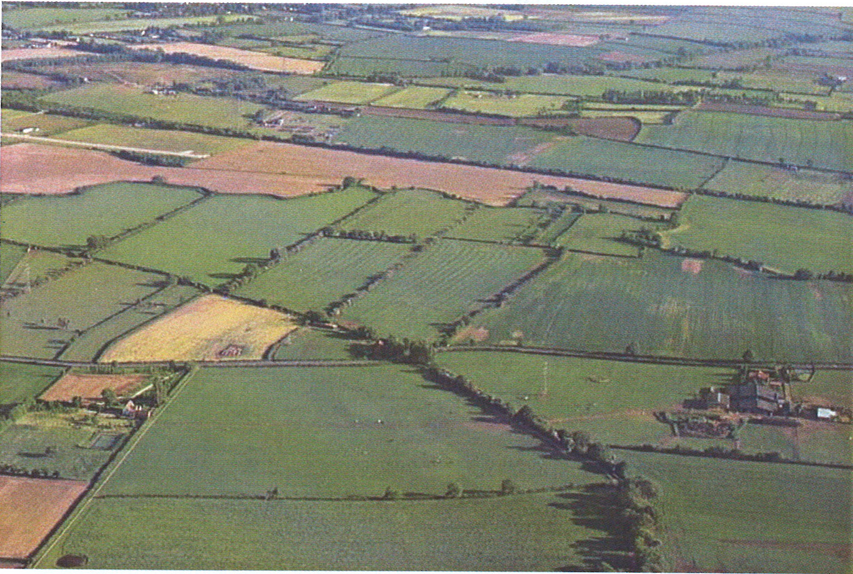
Some Thermal Sources
BGD, p. 94

Slide 44
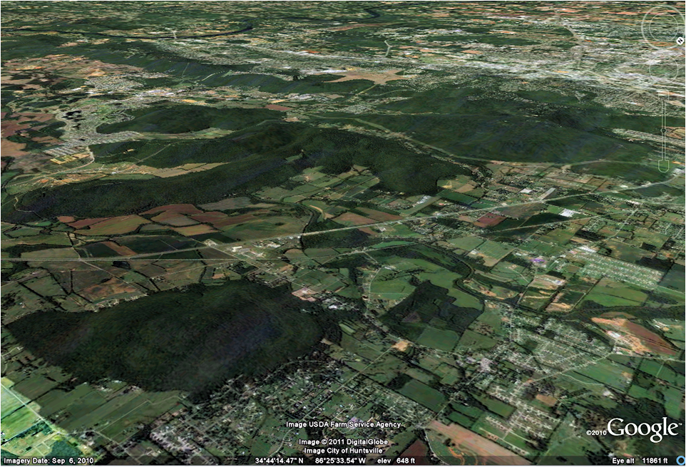
An area you know
Where are the thermal triggers?
Moontown

Slide 45
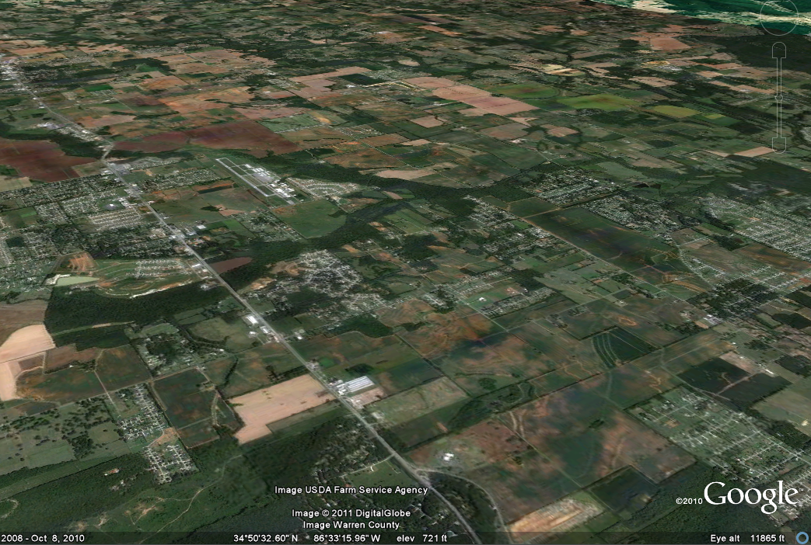
Madison County Exec

Slide 46
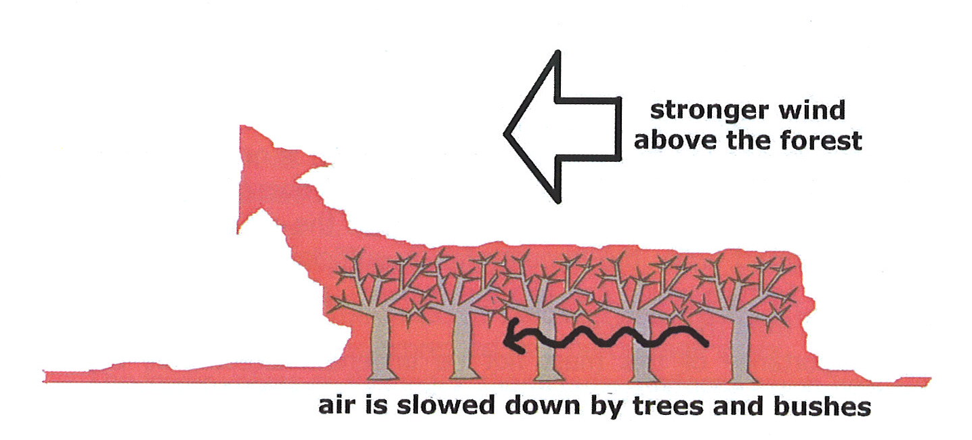
Forests can be good
Especially pine forests that let in some light to the ground – excellent late in the day.
And, even mo’ better, is a clear cut area as they are dark and dry with plenty of brush piles and small clumps of trees to act as triggers.
BGD, p. 96

Slide 47

Why hills and mountains are so good.
Lift
Sink
Beware of this pattern
BGD, p. 98
Sun facing slopes get hotter than the valley.

Slide 48

Some slope shapes are better

Slide 49

Hills often raise the cloudbase
ASME, p. 166

Slide 50

Thermal sources are not always the peak.
BGD, p. 79

Slide 51

When in doubt …
… go to the high ground
ASME, p. 166

Slide 52

Six Week Agenda
  Weather and Preparation (needed skills, glider & instrumentation, biological)
  Thermals and Triggers
  Climbing—and the art of thermaling
  Cruising and In-Flight Decision Making
  Flight Computers and Final Glides
  Outlanding and Post-Flight Analysis

